Slide 1
General Cybersecurity Awareness

Slide 2
Topics
Malware
Spear Phishing
Malicious Links
Passwords
Browsing in Public
Data Compromise
Notes:
Malware
Spear Phishing
Malicious Links
Passwords
Browsing in Public
Data Compromise

Slide 3
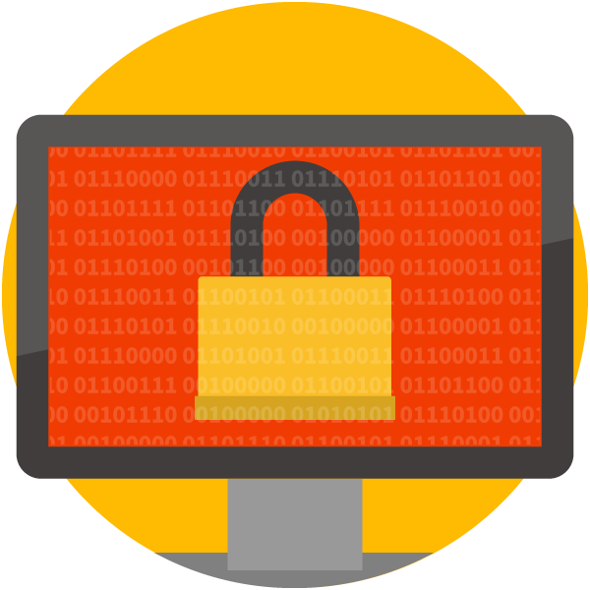
Threat: Malware
Software designed to compromise a device/network
Examples:
Worm/virus
Botnet
Banking Trojan
Ransomware
Notes:
Software designed to compromise device/network
Examples:
Worm/virus
Runs program without permission of user and spreads itself to other computers. A virus requires a host file and a worm is standalone software.
Botnet
A ‘bot’ makes your computer do things (e.g. participate in a DDoS attack). A network of bots is a ‘botnet’.
Banking Trojan
Provides a backdoor into your device so that attackers can monitor browser activity and steal your banking credentials
Ransomware
Holds files for ransom, typically in a cryptocurrency like Bitcoin.

Slide 4
Threat: Malware
Ransomware
Billion dollar threat (and rising!) [1]
Encrypts/locks files
Holds files for ransom
Typically obtained via:
Spam & phishing emails
Unpatched security vulnerabilities
Notes:
Billion dollar threat
In 2016, ransomware-related attacks resulted “in estimated losses of well over $1 Billion”, according to researchers at PhishMe. Several studies anticipate an even higher number in 2017 and beyond.
Encrypts/locks files
Encryption makes files inaccessible without a “key”. In the case of a ransomware attack, the only person with the key is the attacker.
Holds files for ransom
Attackers offer to return/unlock your files only after a ransom has been paid.
Obtained via:
Spam & phishing emails
Spam and phishing emails are the most common vector for a ransomware attack.
Often paired with other malware.
The web (malicious ads & P2P)
Opportunistic attackers may use compromised websites and torrenting/file-sharing sites to distribute ransomware.
Unpatched security vulnerabilities
Significant ransomware campaigns like “WannaCry” and “not-Petya” used vulnerabilities in operating systems/software to distribute malware.

Slide 5
Threat: Malware
Ransomware
1
2
Notes:
Recognizing Ransomware: Payment Site.
If your device is infected with ransomware, you will be directed to some sort of payment site, depending on the type of ransomware. At this point, your first instinct might be to pay, but you should keep your cool and follow the instructions later in this presentation.
The site will typically notify you that your files are encrypted.
The site will demand that you pay a ransom in order to receive access to your files.
Image courtesy of PhishMe’s “Malware Year-in-Review: 2016”.

Slide 6
Best Practices: Malware
Learn to identify phishing emails
Exercise caution with links
Do not download suspicious files
Keep software up-to-date
Back files up regularly
Notes:
Learn to identify phishing emails
Exercise caution with links
Do not download suspicious files
Keep software up-to-date
Back files up regularly
Be mindful of your backup drive: Disconnect back up drive when not in use to prevent infection.

Slide 7
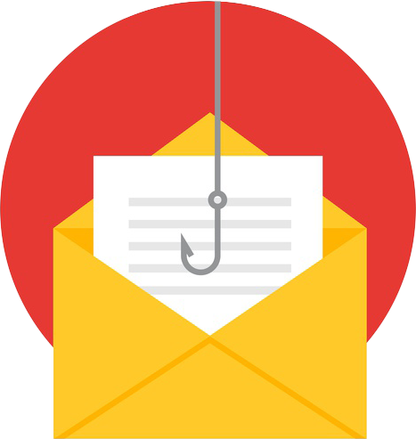
Threat: Spear Phishing
Common cause of data breaches
Targeted emails
Sent to small groups or individuals
Use social engineering tactics
90+ percent of incidents/breaches [2]
Notes:
Common cause of data breaches
Targeted emails
Sent to small groups or individuals
Use social engineering tactics
Examples of social engineering tactics:
Pretexting: Exploiting the authority of another person or organization (e.g. pretending to be the IT department to solicit a password)
Baiting: dangling an item (or file) of value
Appealing to emotions or sense of urgency
In a study of at least 1,600 incidents 800 breaches, the 2017 Verizon DBIR states that phishing was used in “found in over 90% of both incidents and breaches”.

Slide 8
Example of a Spear Phishing Email
1
2
3
4
5
Notes:
Example of spear phishing email.
Indicators in this email:
Highly personalized: the email includes the recipient’s email address, for example.
“As you asked” – Conversational tactic meant to trick the recipient into thinking this email was solicited or requested.
“posted in 1 days [sic]” – Establishes a sense of urgency (note the poor spelling/grammar).
“Passwd is jfg…” – Passwords, a security measure, make the attachment appear more secure.
Password-protected zip files are known to get past spam and malware filters. This may be a measure to ensure the file makes it to the target’s computer.
Prompts the user to download an attached file, click a hyperlink, or submit information.

Slide 9
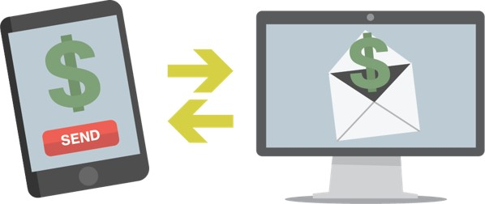
Threat: Spear Phishing
Business Email Compromise
Solicits wire transfer
Impersonates executive, vendor, or supplier
Resembles spear phishing
Targets financial officers
Notes:
A Business Email Compromise scam uses emails to trick recipients into initiating a fraudulent wire transfer, often by impersonating a high-ranking executive or a vendor/supplier.
Business Email Compromise scammers use the same tactics as spear phishers, but with the objective of initiating a wire transfer instead of getting the recipient to download an attachment or click a link.

Slide 10
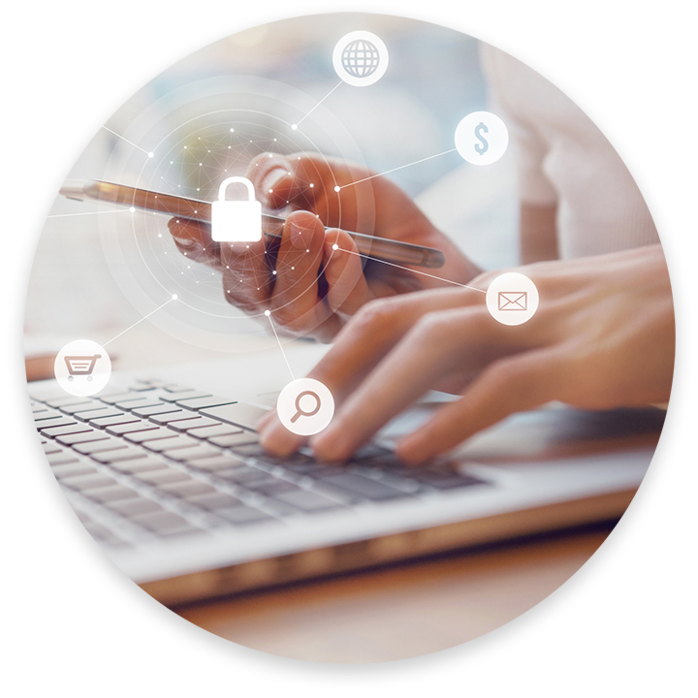
Best Practices: Spear Phishing
Check the sender
Look out for warning signs
Think before you click or take action
Never hand over sensitive info
Notes:
Check the sender
Do you recognize the sender’s address?
Is the reply-to address the same as the sender address?
Can you verify the email from a contact with a telephone call, text message, or chat?
Look out for warning signs
Grammatical errors
Contextual clues (e.g. “Sent from my iPhone” – sender uses Android)
Appeals to strong emotions (e.g. fear, greed, curiosity)
Creates a sense of urgency (e.g. “Act now” or “Please respond within 24 hours”
Unsolicited file attachment or hyperlink
Requests your password or other sensitive information
Think before you click or take action
Read everything carefully and don’t just click a link out of curiosity
Be mindful of company policy and observe whether the request seems odd or out of place.
Never hand over sensitive info
No organization should ever solicit your password or other private information

Slide 11
Threat: Malicious Links
Anchor may hide true destination
Hacked landing pages
Copycat domains (exampel.com)
Shortened links
Notes:
Anchor may hide true destination
Anchor is the visible part of the link – text or image – and the destination is where the link truly leads
Hacked landing pages
Even a site you use frequently can be hacked, so take caution if you receive an unsolicited link or request for your information
Copycat domains (exampel.com)
Spear phishers will purchase domains resembling recognized, known domains, or they will use subdomains to trick you (www.example.com.something-else.com)
Shortened links
You can’t view the destination of a shortened link without running it through a special program.

Slide 12
Best Practices: Malicious Links
Always check the destination
Desktop: hover over anchor
Mobile: hold for several seconds
See It In Action!
https://www.example.com/totally-legit.html
(http://www.example.com.some-other-site.co.uk/downloads/file.php)
Notes:
Always check the destination
Desktop: hover over anchor
Rolling your mouse pointer over the link will allow you to preview the destination in the corner of the window or beneath the mouse pointer.
Mobile: hold for several seconds
Most mobile devices allow you to “tap and hold” to preview the link. Be careful not to simply tap the link as this will follow it.
Presenter activity: hover over the link to show anchor vs. destination.
Instructor hovers over the hyperlink to show the destination (alternately, they can click through to show the destination on the slide).
Warning signs in the destination link:
Doesn’t match anchor
https vs. http: true destination leads to unencrypted website
“www.example.com” vs “www.example.com.some-other-site.co.uk” – subdomains vs domains
Destination URL appears to go to a download link, and may download file to the user’s device when visited.

Slide 13
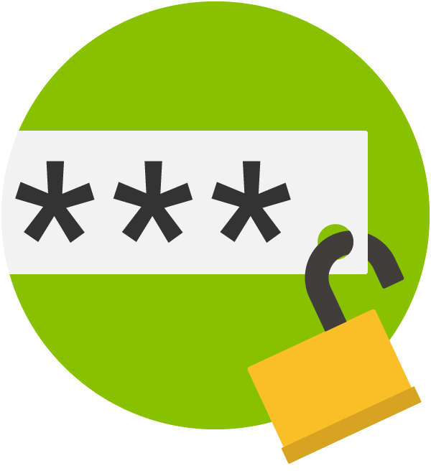
Threat: Password Security
Susceptible to:
Brute force
Hacking
Malware
Phishing
Data breach
Notes:
Susceptible to:
Brute force
Attackers trying one possible password after another. They can try several thousands of combinations in minutes.
Hacking
Gaining entry to the server illicitly
Malware
Can be used to monitor activity or keystrokes. May be on the server or on your computer.
Phishing
Simply asking for your login credentials.
Data breach
The server is breached, often using one of the methods listed below.

Slide 14
Best Practices: Password Security
Effective passwords are:
Long
Complex
Unique
Rotating
Enable MFA where possible
Yes
No
9@kj*YbM25nGnl
p@ssw0rd12
Notes:
Effective passwords are:
Long
At least 8 characters, but longer is better.
Complex
Use special characters, uppercase and lowercase letters, and numbers. Avoid easy-to-guess phrases and words.
Avoid words that might double as “security question” answers. Don’t use friend/significant others’ names, birth dates, high school mascots, etc.
Unique
One unique password for each account. Don’t reuse passwords.
Rotating
Change your passwords proactively – once every 90 days is a good guideline.
Enable MFA where possible
Turn on multi-factor authentication to require a second device in addition to your password.

Slide 15
Threat: Browsing in Public
Unsecured networks
“Man in the Middle”
Visual hacking
Stolen and misplaced devices
44% of stolen devices were left in a public place [3]
Notes:
Unsecured networks
“Man in the Middle”
A “Man in the Middle” attack is when an attacker sets up a phony free wifi network to impersonate a legitimate free wifi network.
Visual hacking
Looking over someone’s shoulder or glancing at their screen.
Stolen and misplaced devices
A poll conducted by Lookout Mobile indicated that 44% of people who had their devices stolen left the device in a public place. An additional 11% said the device was stolen from their person.

Slide 16
Best Practices: Browsing in Public
Avoid public wireless networks
Use reputable VPN
Be mindful of surroundings
Precautionary apps
“Find my phone”
“Remote wipe”
Notes:
Avoid public wireless networks
Unsecured networks can be accessed by anyone
Use reputable VPN
A VPN masks your activity by using your connection to connect you to a different network.
Be mindful of surroundings
If someone is making you feel uncomfortable, move to a place where you feel safer. If it continues, report the behavior to the supervisor or other authority.
Precautionary apps
“Find my phone”
Allows you to locate a stolen/misplaced device
“Remote wipe”
Allows you to restore a stolen/misplaced device to factory settings, so that attackers cannot access your information

Slide 17
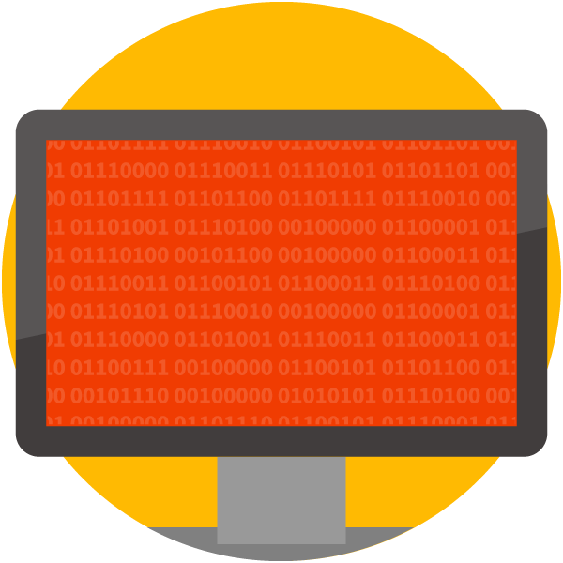
Threat: Data Compromise
May result from:
Spear phishing
Hacking or malware
Simple negligence
Average cost: $3.62 MM [4]
Notes:
May result from:
Spear phishing
Hacking or malware
Simple negligence
An employee CC’ing the wrong person on an email; leaving classified documents in a public place; leaving their computer unlocked when they leave their desk; etc.

Slide 18
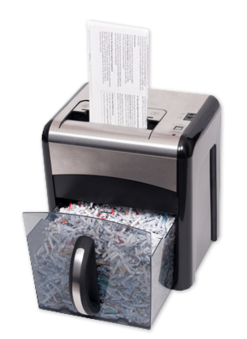
Best Practices: Data Compromise
Storing sensitive information:
Yes to encrypted devices
No to removable media (flash drives)
Sharing:
Who is authorized?
Check CC’s
Secured network?
Destruction:
Recycle bin is not enough!
Notes:
Storing sensitive information:
Yes to encrypted devices
If you are unsure about device encryption at work, ask a supervisor
No to removable media (flash drives)
Check company policies on removable media and DO NOT remove classified information with a flash drive or other unauthorized device
Sharing:
Who is authorized?
Your co-workers might not be authorized to see or hear the information. Check your volume and be sure no one can overhear your conversation(s).
Check CC’s
Don’t copy someone on an email if it contains information they are not allowed to see.
Secured network?
Don’t share sensitive information over an unsecured network where attackers can snoop on the information that is sent.
Destruction:
Recycle bin is not enough!
Instead, use a secure wipe method when getting rid of a hard drive. Shred paper documents. See IT team for more information on best practices.

Slide 19
Improve Cybersecurity by Reporting Threats
Report any suspected threats
Help stop attacks
Protect your co-workers
Protect customer data
Report It!
Notes:
Report any suspected threats
Prompt reporting allows our IT team or security provider to respond before more damage is done
Help stop attacks
Protect your co-workers
If they’ve targeted you, they may have also targeted other people that you work with or for.
Protect customer data
Any successful cyber attack puts sensitive customer data at risk.
Prompt reporting satisfies an obligation to our customers by doing our best to prevent the loss or breach of sensitive information.

Slide 20
Related Resources
[1] – Malware Year-in-Review: 2016, PhishMe.
[2] – Verizon’s 2017 Data Breach Investigations Report, Verizon.
[3] – People Are Willing To Go To Extreme Lengths To Retrieve Their Stolen Smartphones, Business Insider.
[4] – Ponemon Institute’s 2017 Cost of Data Breach Study: Global Overview, Ponemon Institute, sponsored by IBM.

